Slide 1
Context

Slide 2
Objectives
When to Use Context
Before You Use Context
API

Slide 3
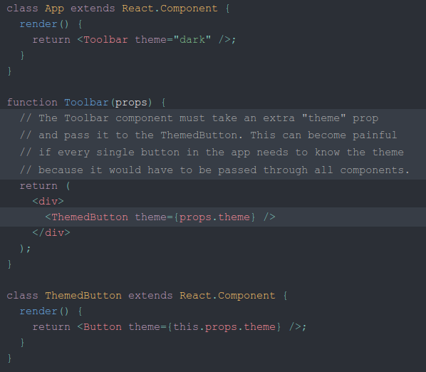
When to Use Context
Context is designed to share data that can be considered “global” for a tree of React components, such as the current authenticated user, theme, or preferred language. For example, in the code below we manually thread through a “theme” prop in order to style the Button component

Slide 4
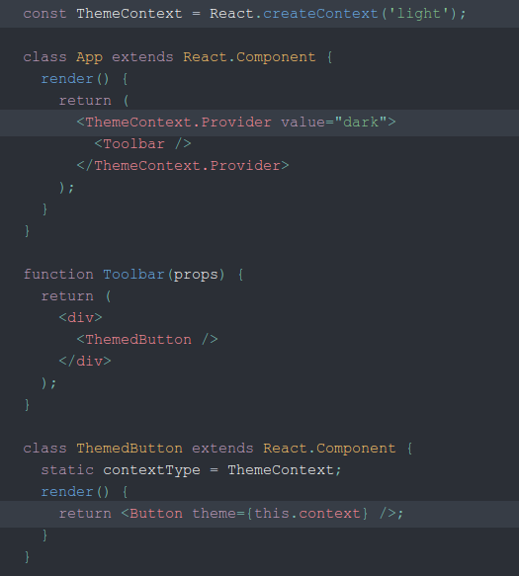
When to Use Context
Using context, we can avoid passing props through intermediate elements

Slide 5
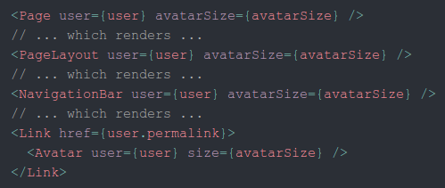
Before You Use Context
Context is primarily used when some data needs to be accessible by many components at different nesting levels. Apply it sparingly because it makes component reuse more difficult.
If you only want to avoid passing some props through many levels, component composition is often a simpler solution than context.
For example, consider a Page component that passes a user and avatarSize prop several levels down so that deeply nested Link and Avatar components can read it:

Slide 6
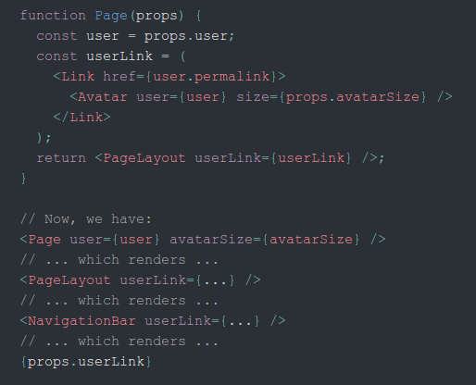
Before You Use Context
One way to solve this issue without context is to pass down the Avatar component itself so that the intermediate components don’t need to know about the user or avatarSizeprops:

Slide 7
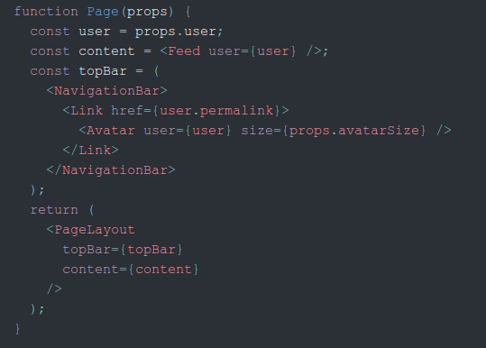
Before You Use Context
You’re not limited to a single child for a component. You may pass multiple children, or even have multiple separate “slots” for children, as documented here.

Slide 8
API
React.createContext
Creates a Context object. When React renders a component that subscribes to this Context object it will read the current context value from the closest matching Provider above it in the tree.
The defaultValue argument is only used when a component does not have a matching Provider above it in the tree. This can be helpful for testing components in isolation without wrapping them. Note: passing undefined as a Provider value does not cause consuming components to use defaultValue.

Slide 9

API
Context.Provider
Every Context object comes with a Provider React component that allows consuming components to subscribe to context changes.
Accepts a value prop to be passed to consuming components that are descendants of this Provider. One Provider can be connected to many consumers. Providers can be nested to override values deeper within the tree.
Changes are determined by comparing the new and old values using the same algorithm as Object.is.

Slide 10
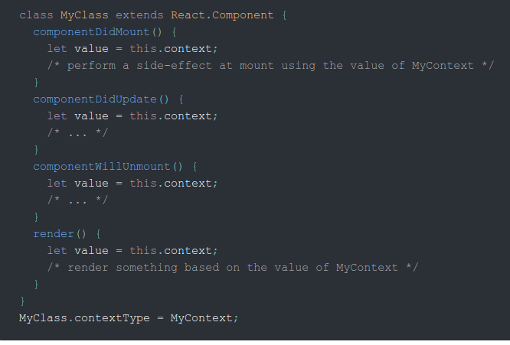
API
Class.contextType
The contextType property on a class can be assigned a Context object created by React.createContext(). This lets you consume the nearest current value of that Context type using this.context. You can reference this in any of the lifecycle methods including the render function.

Slide 11

API
Context.Consumer
A React component that subscribes to context changes. This lets you subscribe to a context within a function component.
Requires a function as a child. The function receives the current context value and returns a React node. The value argument passed to the function will be equal to the value prop of the closest Provider for this context above in the tree. If there is no Provider for this context above, the value argument will be equal to the defaultValue that was passed to createContext().

